Slide 1
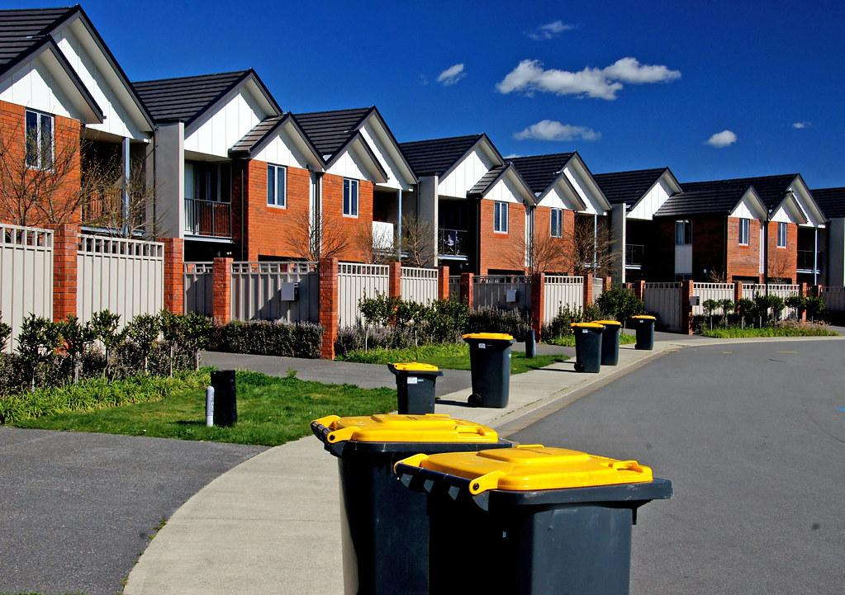

Innovation
Playbook
[16]
Brett Chevalier, Charles Lazimi, Annalina Becker, Shaila Patel, Jaeyong Sin, and Johnny Li

Slide 2
03
08
15
23
25
32
37
53
62
70
73
78
BACKGROUND
STAKEHOLDER ANALYSIS
MARKET RESEARCH
NEEDS SPECIFICATION
COMPETITIVE LANDSCAPE
IDEA GENERATION
PROTOTYPES
FINAL SOLUTION
FEASIBILITY
VALUE PROPOSITION
IMPLEMENTATION STRATEGY
APPENDIX
OUTLINE
Notes:
To be Updated

Slide 3

BACKGROUND
[18]

Slide 4
BACKGROUND:
PROBLEM
In urban environments, it is common to see trash bins and bags line the street, which can negatively impact quality of life for those living or commuting in the community.
Overflowing trash bins cause foul odors and can attract pests and rodents.
In many urban areas, particularly those in older cities where the streets may not be very wide, having trash bins lining the street’s edge can lead to foul-smelling alley-ways.
Americans produce around 254 million tons of trash each year, and as a result, waste management is a $4 billion industry in the United States [3].
.

Slide 5
BACKGROUND:
PROBLEM
Municipal Solid Waste (MSW) refers to the amount of trash or various items in pounds, that consumers throw away.
According to the EPA, in the United States the MSW in 2017 was 267.8 million tons, which comes out to 4.51 pounds per person per day. [3]
This rate of 4.51 pounds per person per day represents a steady decrease from the peak in 2000 of 4.74 pounds [4] , but factoring in population growth, the market is growing in the United States.
The MSW that represents trash sent to landfills combined with that which is recycled accounts for approximately 233 million tons, or 87.3% of all MSW. Trash and recycling bins are the two types of bins that this issue revolves around. [5]
Therefore, one can conclude that waste management is a very large market.

Slide 6
BACKGROUND:
IMPACT
Currently, this problem remains largely unsolved. While the primary focus is on trash bins and bags causing issues in cities within the United States, it should be noted that trash collection and disposal is a much bigger issue in developing countries. Some cities in these countries spend 20-50% of their budgets on waste management[3].
Since 2000, the World Bank has contributed close to $4.5 billion to assist in the funding of over 325 solid waste programs globally[3].
These facts prove there is an additional large market if the solution posed would reduce those costs to local governments or citizens.
.

Slide 7
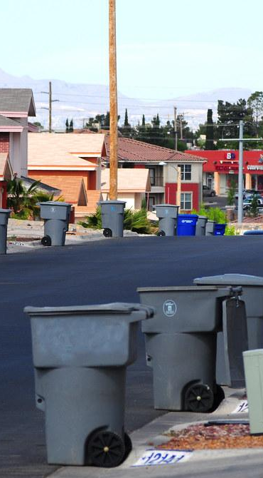
NEED STATEMENT
[17]
“There is a need to decrease odor from trash in residential and high traffic commercial areas.”

Slide 8
STAKEHOLDER ANALYSIS

Slide 9
STAKEHOLDER LIST
Waste disposal employees
State & Local Governments
Pedestrians/Commuters
Environmental regulators
Residents/Community members
Homeless
Safety professionals
Grocers
Restaurants/Food Vendors
.

Slide 10
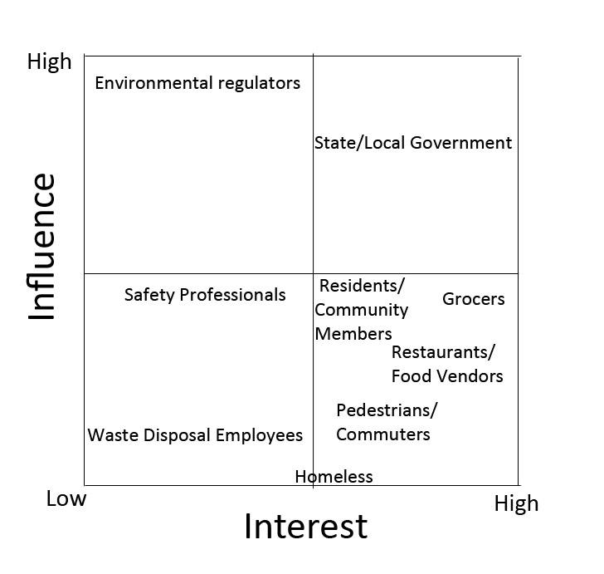
STAKEHOLDER MAP
.

Slide 11
STAKEHOLDER MATRIX
Stakeholder Group | Pains | Gains
Waste Disposal Employees | New system or product to accommodate | Easier, more efficient tasks
State/Local Government | Upfront costs to implement changes, maintenance costs | Long term cost savings, more efficient system of waste disposal
Pedestrians/ Commuters | Increased taxes if implemented local government | Easier to navigate cramped city streets
Environmental Regulators | Potential cost and time to test, approve and regulate | Improvement to health/environment of urban areas.
Community Members/ Residents | Direct cost to consumers, increased taxes if implemented by local gov. | Less eyesore of trash bins/bags, less odor when walking on street
.

Slide 12
STAKEHOLDER MATRIX
Stakeholder Group | Pains | Gains
Homeless | They may not have the means to financially contribute towards this project. | They will not smell the trash and will not see any of the bugs/rodents that come with smelly trash.
Safety Professionals | May have to approve of possible solutions | Less time inspecting cafeterias/ food courts
Restaurants/ Food Vendors | Extra costs on waste, increased taxes if implemented by local gov. | Customers will be more satisfied. More likely to pass health inspections
Grocers | Extra steps may have to be implemented for waste disposal, increased taxes if implemented by local gov. | Minimize unwanted pests
.

Slide 13
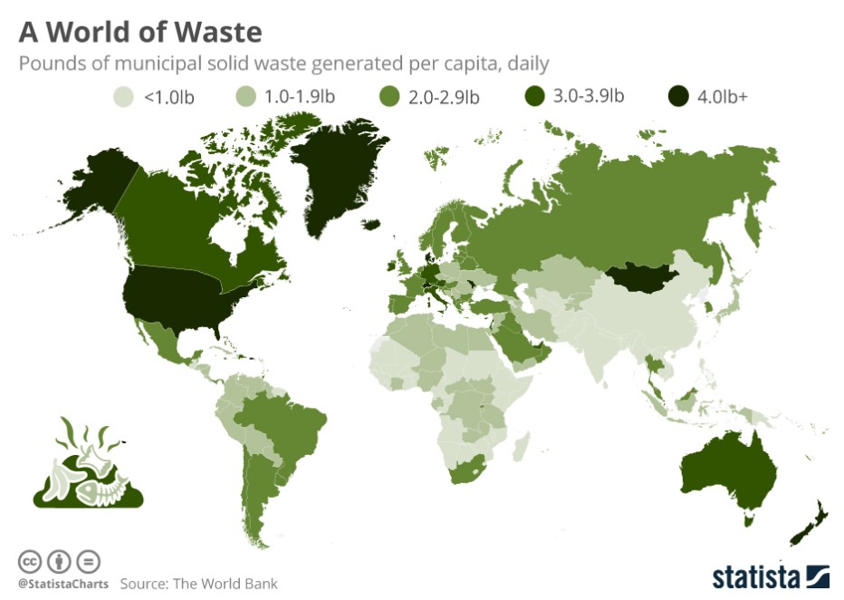
STAKEHOLDER STATISTICS
.
[4]
Notes:
need our own stats

Slide 14
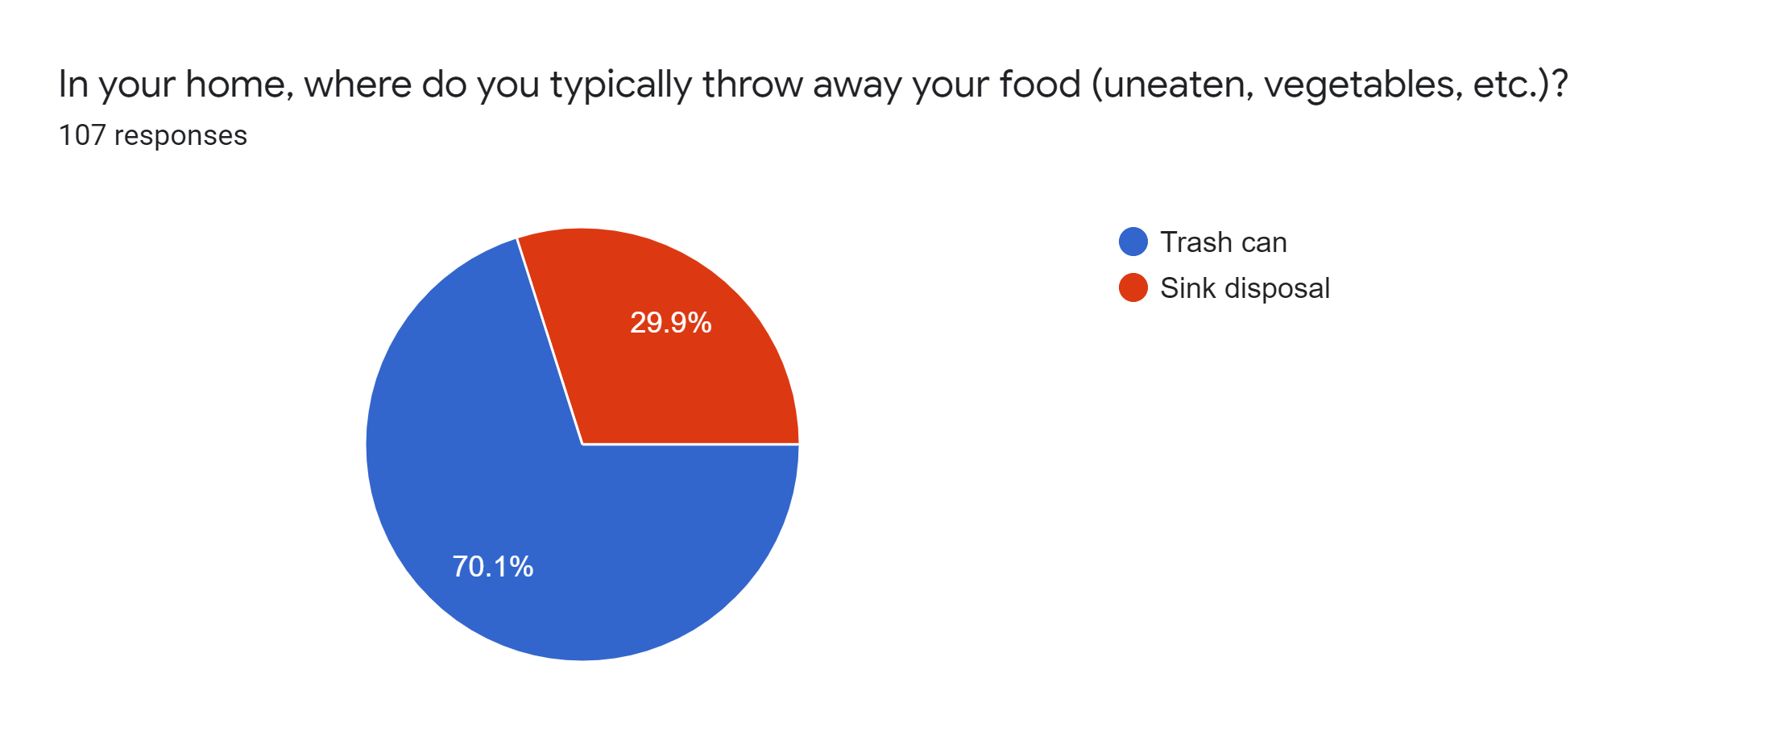
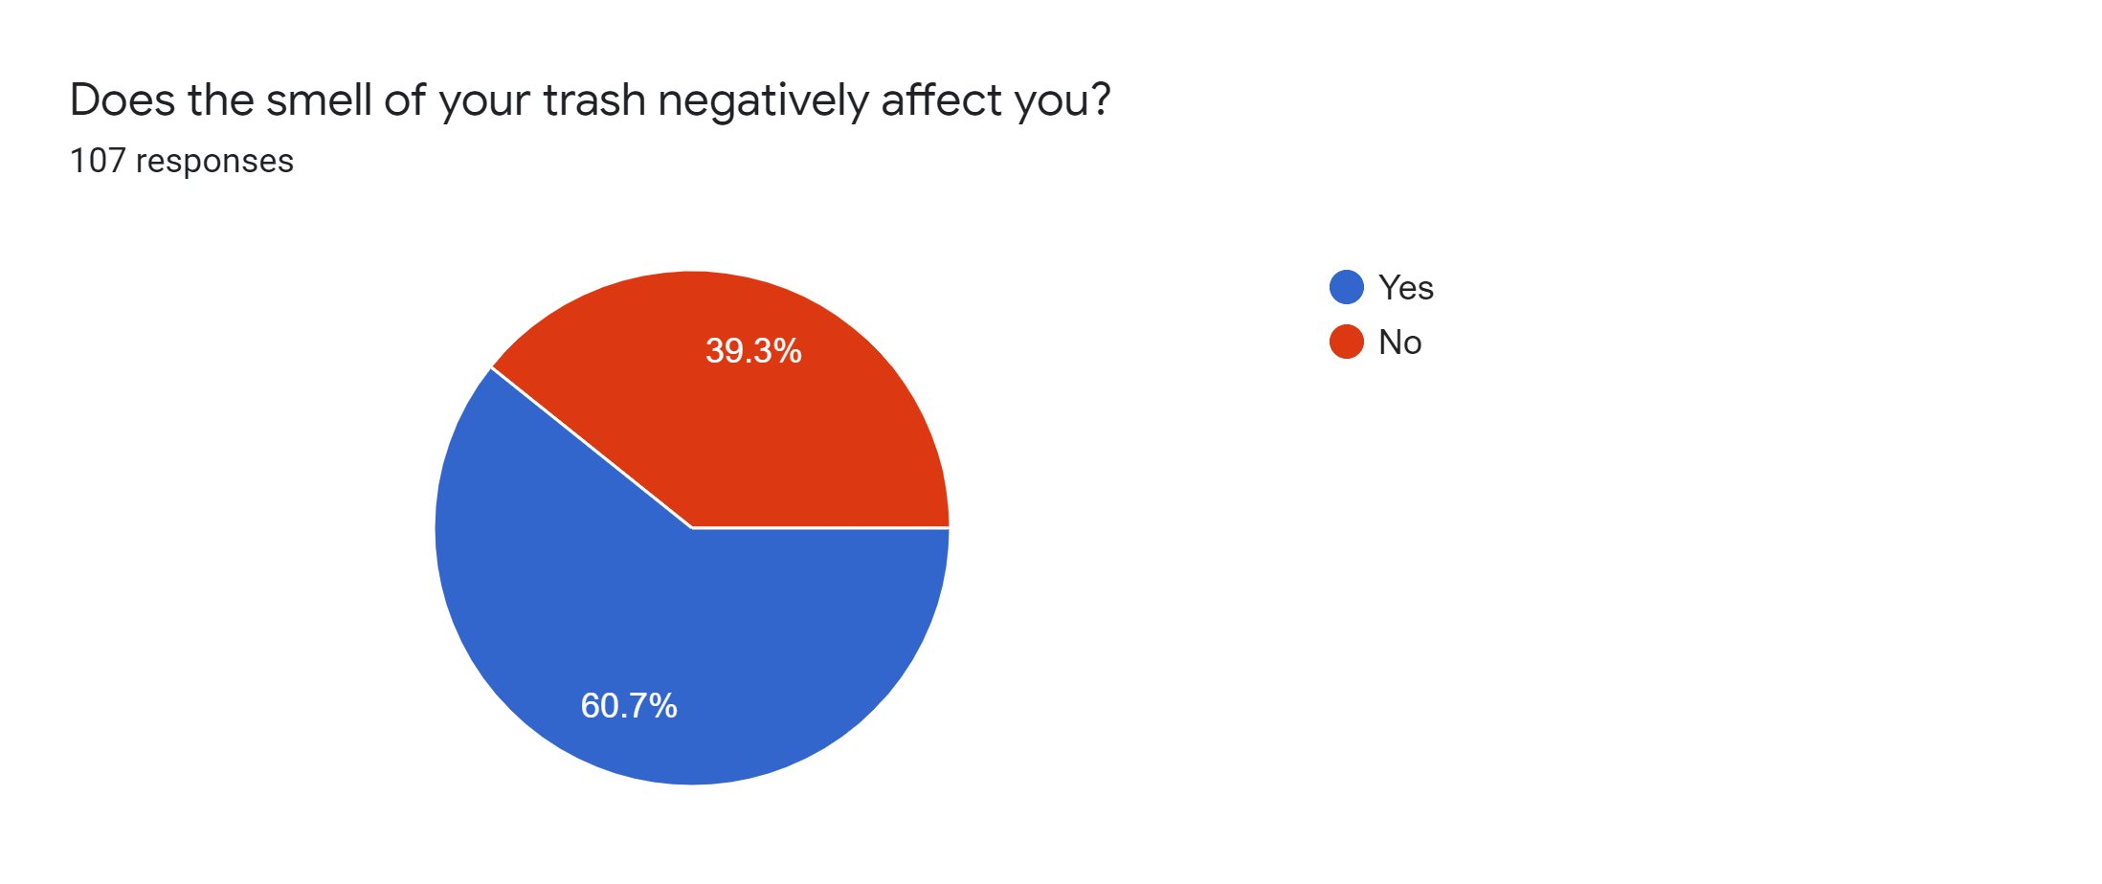
STAKEHOLDER STATISTICS
From the results of our Google Form, it is evident that 70.1% of 107 respondents usually throw their food waste in their trash can. In addition, 60.7% stated that the odor of their trash is apparent and not welcomed.
Notes:
more market research

Slide 15
MARKET RESEARCH

Slide 16
TARGET MARKET
For the urban smellscape, those impacted by the city’s smelled are city’s first-timer visitors because unfamiliar or strong odors are brought to people’s attention (as potential threats or sources of pleasure) [23].
Odorous Zones in U.S. Cities
Odorous Areas in U.S. Neighborhoods
There are approximately 35,000 cities and incorporated municipalities in the U.S. [22]
U.S. Households
In 2019, there were 128.58 million households in the United States [21].
.
Notes:
fix circle diagram

Slide 17
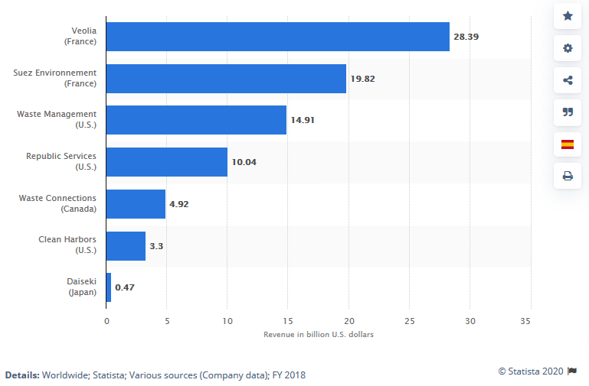
MARKET/ IMPACT
Potential consumers could be waste management companies or government agency tasked with handling waste.
Globally, waste control generates about $400 billion in revenue annually. [11]
Despite the waste industry being perceived as slow moving, investment into digitalizing the waste management industry is expected to grow.
The U.S. Waste Management industry includes about 25,000 establishments (single-location and multi-location companies) with combined annual revenue of about $95 billion. [11]
.
[11]

Slide 18
MARKET SEGMENTS
The mass market approach would not be suitable due to the different needs,factors, and wants of the various locations.
A segmented market approach was taken due to stakeholders having significant different needs and preferences. Examples:
Stakeholder need- Identifying the similar needs and wants of the various stakeholders, it aligns us to better serve their needs.
Value- Stakeholders who seek to minimize their environmental impact.
Price Sensitivity- Wants a cheap solution that will last a long time. (Cheap in respect to their overall budget.)
Lifestyle- Prefer not to disrupt current lifestyle of customers or the adjustments should make the process easier for employees.
Stakeholder Preferences- Wants a product to be affordable and simple to implemented, should not disrupt current method of doing things.
.
Notes:
more market research

Slide 19
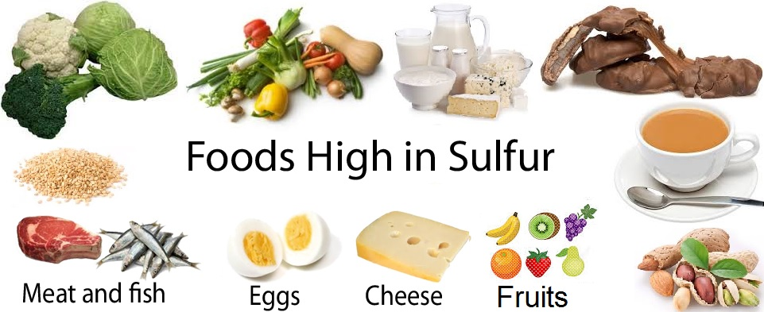
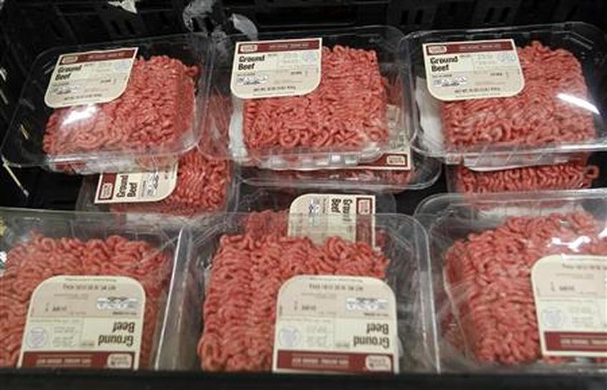
SOURCE OF ODOR
Organic waste can make up ~70% of the total flow of waste [29].
Odor stems from the subsequent bacterial breakdown of these organics.
This odor is dependent on the compound’s individual odor threshold (the amount at which we can physically smell it).
Sulfur-containing compounds give off a rotten egg or cabbage type smell
Low odor threshold
Nitrogen-containing compounds such as amines & cadaverine stem from meat decomposition
High odor threshold
Plastic packaging on meats [14]
[24]
.
[25]
Notes:
more market research

Slide 20
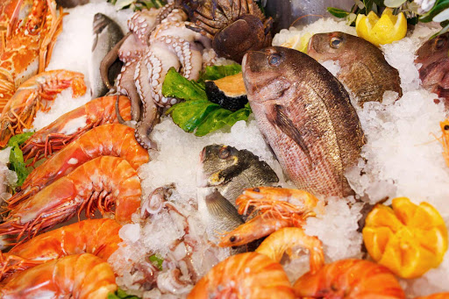

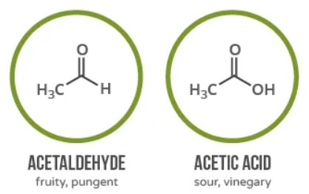
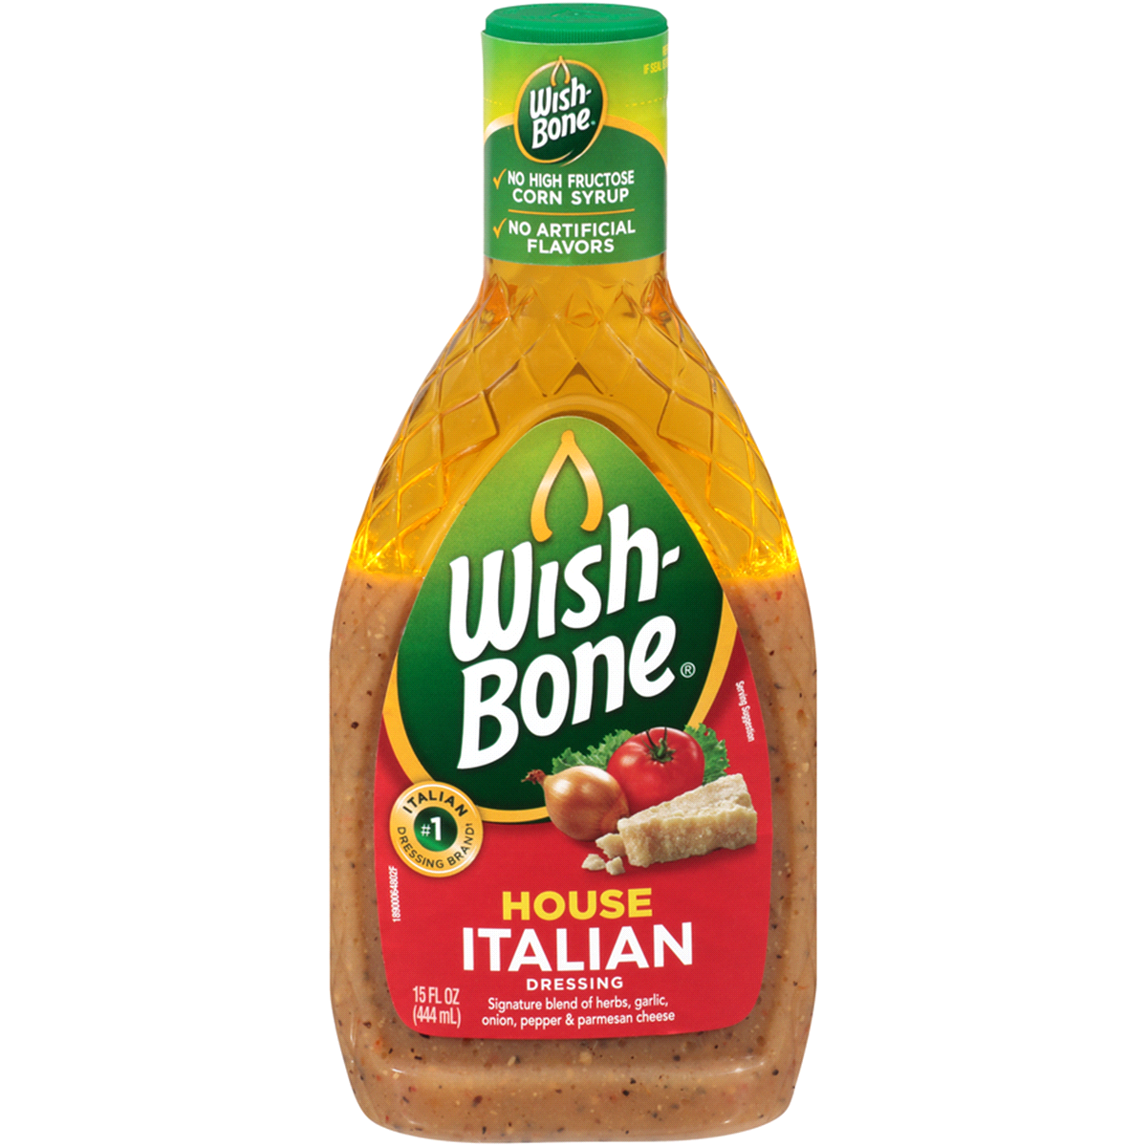
SOURCE OF ODOR
Ammonia- containing compounds have a high threshold
Trimethylamine smells fishy [14]
Other compounds are generated from anaerobic decomposition & when mixed with other potent compounds produce powerful scents [14]
[26]
.
[28]
[27]
[14]
Notes:
more market research

Slide 21
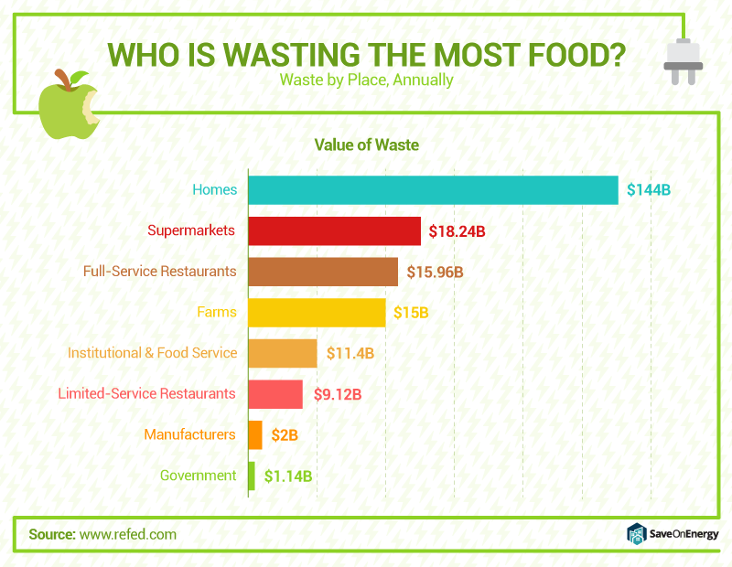
MARKET IMPACT
According to a report from ReFED, food waste is seen across many different markets. However, 80% is sourced from homes and consumer-facing businesses [32].
[32]
Notes:
more market research

Slide 22
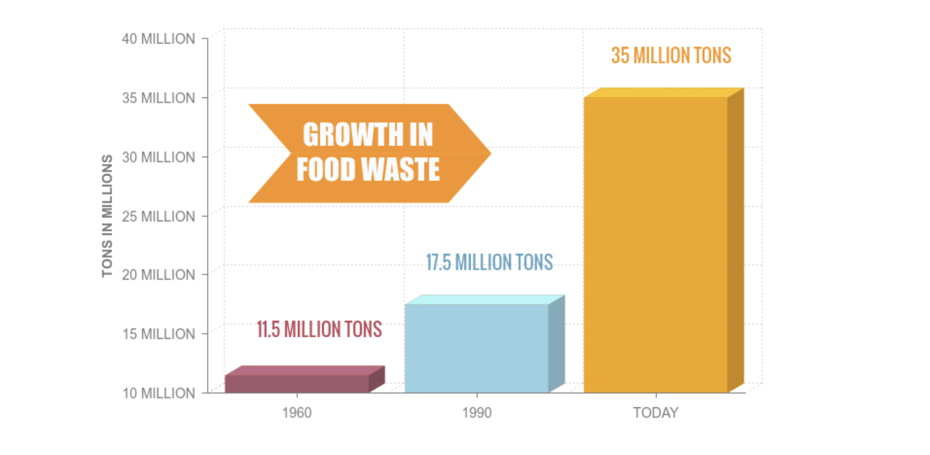
MARKET GROWTH
Most Americans are living in bigger households this decade.
67% of 35 to 54 year olds lived in a household of 3 or more people in 2017 [31].
Bigger households means a greater volume of trash due to the fact that the average person in the U.S. produces 4.40 pounds of waste daily.
In a year, the average person in the U.S. produces 220.96 pounds of food waste [30].
[33]
Notes:
more market research

Slide 23
NEEDS SPECIFICATION

Slide 24
Customer Comment | Translated Need
“It is an issue but not something I’d spend a whole lot of money on.” | Solution/product needs to be low cost (< $20). Based on a Google form survey we conducted with sample size of 33, over 2/3 of respondents said the solution should be $20 or less.
“What’s the point of just me buying a new kind of trash bin or something (if the point is to reduce street clutter)?” | Community level implementation of the solution may be ideal. However, since the time this feedback was collected, the aim of our project has shifted from street clutter to residential trash smell.
“I wouldn’t use it if it’s too complex.” | The solution must not have a large amount of steps (not more than 3 steps) or any complex processes for the user to learn. We should aim for setup time to be one minute or less.
“If it’s a new kind of garbage can it should be light enough to carry (to the street).” | Solution must be lightweight (less than a pound) and manageable for even elderly individuals. Therefore, we should avoid creating any form of a heavy trash can.
“I’d be less likely to use whatever it is if it gives less space than a normal trash can.” | Based on a Google form survey we conducted with a sample size of 27, solution must not occupy more than 4% of a standard trash can (15 gallon).
“Sometimes liquids are spilled into trash bins, I would only use the product if it was water-proof” | Solution must be durable and withstand liquids being spilled on it, also needs to be weather resistant if being used outside.
.
Notes:
need to be measurable
whats the maximum trash volume

Slide 25
COMPETITIVE LANDSCAPE

Slide 26
CURRENT SOLUTIONS
Odor Absorbing Trash Bags - Many trash bag producers offer odor reducing or absorbing bags
Pros: No habit changes - consumer just uses these bags as they would normally
Cons: More expensive than standard trash bags
Trash Bin Deodorizers - There are products on the market used to deodorize trash bins
Pros: Mitigates the smell issue
Cons: Only effective when bin owner decides to use it
Local Community Regulations - Many local communities have rules about where and when one can put their trash
Pros: Prevents trash from being on the street constantly
Cons: Not heavily enforceable, doesn’t prevent odor problem in the time and place trash is permitted to be
Waste Reduction Advertisement Campaigns - Some governments have implemented advertising to encourage citizens to reduce the amount of waste they produce
Pros: Helps cut off odor issue at its source by encouraging people to produce less waste
Cons: Effectiveness is unknown, not strongly advertised
Composting - Some consumers choose to compost much of their waste
Pros: Less waste makes it to the trash can and thus onto the street
Cons: Simply relocates the smell issue, may attract animals/pests
.

Slide 27
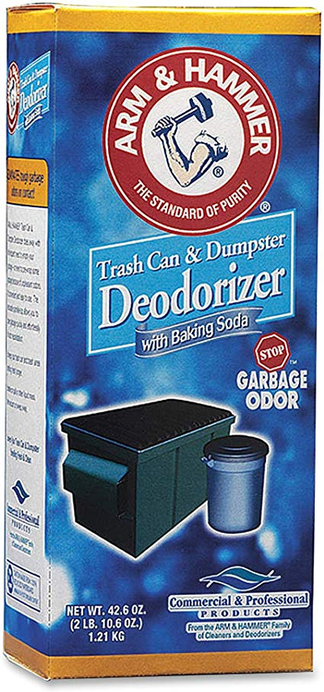
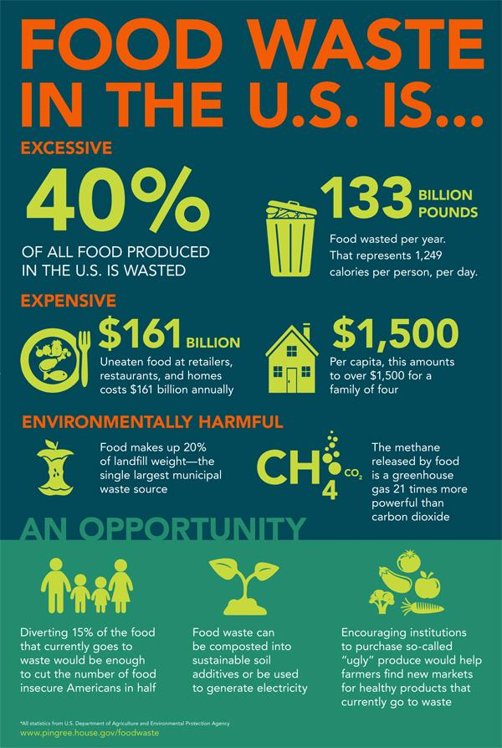
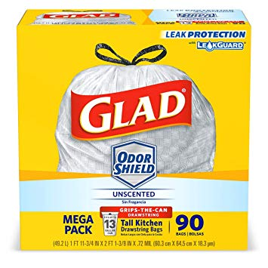
CURRENT SOLUTIONS
Trash Bin Deodorizer Products
Arm & Hammer
Rubbermaid
Local Community Regulations
Waste Reduction Advertisement Campaigns
Composting
Odor Absorbing Trash Bags
Hefty
Glad
.

Slide 28
CURRENT SOLUTIONS ANALYSIS MATRIX
Solution/Factor | Low Cost (< $20) | Easy to Use | Reduces Odor | Reduces trash on street | Community Level Implementation
Arm & Hammer Deodorizer | ✅ | ✅ | ✅ | ☒ | ☒
Rubbermaid Deodorizer | ✅ | ✅ | ✅ | ☒ | ☒
Community Regulations | ☒ | - | - | ✅ | ✅
Waste Reduction Ads | ☒ | - | - | - | ✅
Composting | - | ☒ | ☒ | ✅ | ☒
Hefty Odor Absorbing Trash Bags | ✅ | ✅ | ✅ | ☒ | ☒
Glad Odor Shield Trash Bags | ✅ | ✅ | ✅ | ☒ | ☒
.

Slide 29
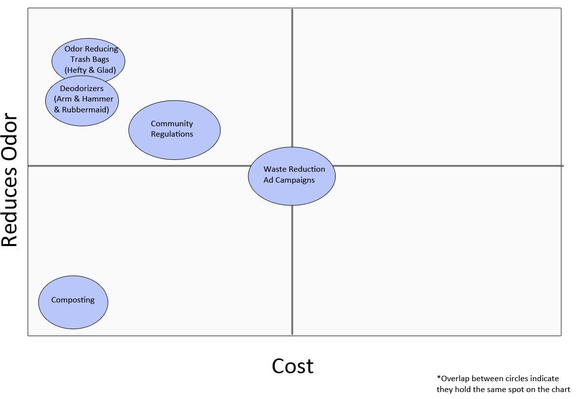
WHITE SPACE ANALYSIS
.

Slide 30
PORTER’S FIVE FORCES ANALYSIS
Suppliers
1. There is low competition among suppliers
2. Low cost of supply, reusability
New Entry
1. Low barriers to entry
2. Not much experience is needed to install the device
3. Uniqueness of the product
Rivalry among existing Competitors
1. Low customer loyalty
2. Low switching costs
3. Few competitors
4. Product differentiation
Substitute Products
1. Not much threat of substitution, there are not many products that target long-term deodorizers in trash bin
Buyers
1. Replacement deodorizer capsules to decrease cost of maintaining the product.
2. Difference between competitors
.
Notes:
rivalry among existing competitors missing for porters. → adressed

Slide 31
IP LANDSCAPE
What is the Intellectual Property Landscape surrounding your solution?
There are some patents for malodor reduction compositions, such as those used in garbage bags, air fresheners, dryer sheets, etc. There are currently many patents for odor detection, but none for the application of waste
Is it patent heavy?
There are patents involving odor detection and elimination for trash bins or
storage containers.
Yes, there is a need to patent our external trash can attachment device for odor detection and elimination.
Almost everyone contributes to waste around the world, rendering products in this market very profitable. Patents are essential, otherwise many companies could capitalize on the same product.
More geared toward copyrights or trade secrets?
Our scented compounds will be trade secrets.
Is IP important to this solution?
Yes, the design of the application would need to be protected against infringement.
No other solution that addresses trash odor implies both an odor detector and eliminator, therefore protecting our product is essential.
What patents exist to address this solution?
Scented trash bags (KR20180053579A) [19]
A Food Trash Odor Removal Unit and Method thereof (KR20050014327A) [20]
.
Notes:
need more IP

Slide 32

IDEA GENERATION

Slide 33
REVERSE THE PROBLEM
Harder | Solution
Never clean trash can | Self cleaning trash can
No Trash bags | Container for trash
Use a fan to push bad smell around | Use a container that avoids airflow from entering/ exiting
Put all trash in one area | Have dividers for trash, multiple disposal sites
No trash dump sites | Thermal generator/ Incinerator
No law/citation against littering | Enforce community regulations
Only eating the stinkiest food | Throw it into your sink disposal instead of the trash
Vacuum sealer for trash bag that spews smelly air out | Sanitize/purify the air spewing out. Use another item such as spray to mask the smell
Ban against nose plugs | Permanently remove sense of smell at birth
Garbage collectors come less often (once a month) | Uber but for trash, can order someone to pick up on a daily basis
Less recycling/ composing | Promote more recycling/ composing
.
Notes:
This table may need to be separated into two slides

Slide 34
BRAIN WALKING
Charles: Vacuum seal lid for trash cans, uber for your trash, inhaling a molecule through your nose to trick your brain into smelling something other than a foul odor, Nose plugs, A method of shooting into space, giant plastic wrap, neighborhood compactors, neighborhood burial sites
Brett: Uber for trash, a Febreze-like spraying trash can, Trash can which incinerates contents, Trash bag which ties itself off and vacuum seals the bag. “Odor Bomb” which is put into trash can to absorb odor or destroy chemicals which produce odors
Jaeyong: Compact the trash, making it into a manageable size, then spray with odor absorbing liquid which is washed away after. Burn the trash, use it as some sort of fuel. Bury the trash, or use it as a building material. Give usable food waste to farms to feed animals. Inhaler for your nose that keeps a pleasant smell when around foul odor.
Annalina: Burning in a thermal generator, spray like Febreeze such as routine air spray by planes, decreasing/limiting products that go in trash, compact trash and extract odor and purify that odor, at home smusher, install fees for controlling odor, space trash management facility utilizing trash for fuel
Johnny: Raw waste is to compost. Cooked waste is to be animal feed. Food waste turning compost into fertilizer for plants, masking smell or using trash for their food. Vacuum sealed container for food waste to stay in until it makes it to the animeals. Use tightly sealed composting container to prevent odor leakage.
Shaila: Bacteria that eats trash and emits compost, Air purifying plants, Fee for not composting, Incentive for composting, At home method to transform plastic, Driving very far away to throw away trash, Recycle, Mandatory, Bulk items to be crushed or repaired, Promote waste reduction through social activities, App to monitor odor/waste, stores/trash management facilities rewarding people who bring and recycle trash, Flowers grown from trash and then sold to keep up with the cost, Better funding for recycling facilities, tax incentives for recycling, Composting containers are tightly sealed
.

Slide 35
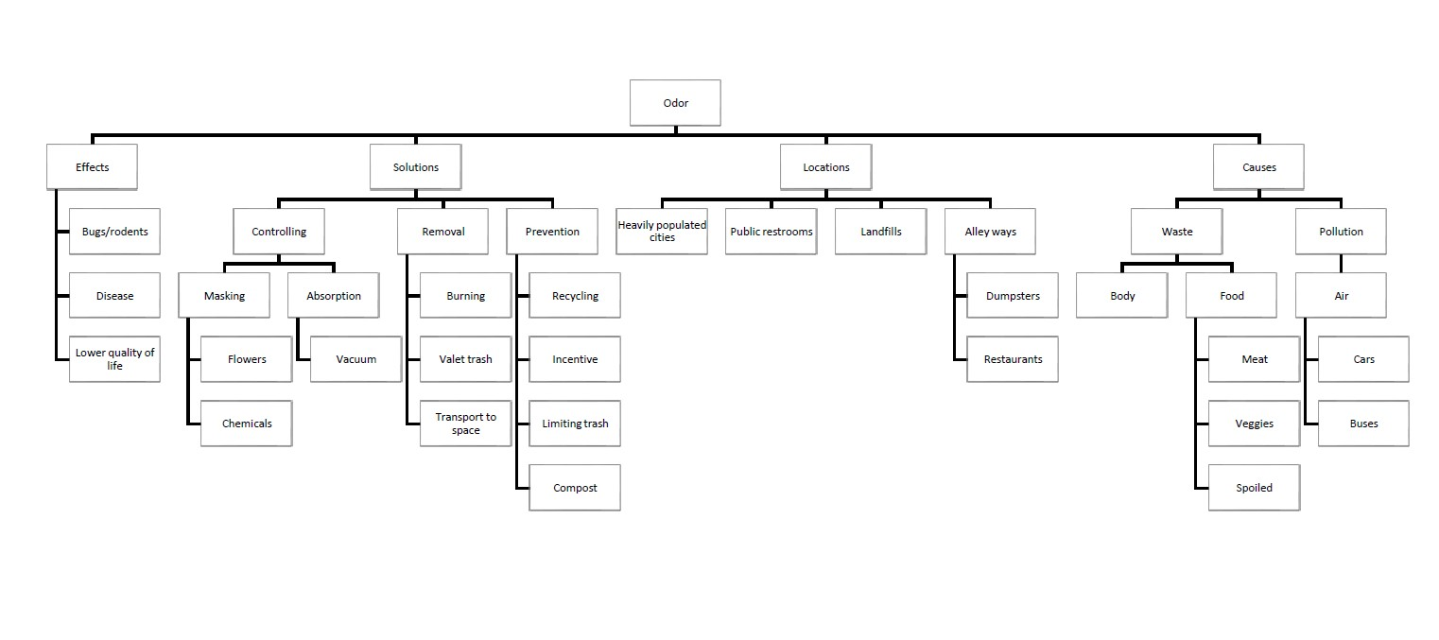
MIND MAPPING
.

Slide 36
WORST IDEAS
Johnny: Burning trash, Force taxation on cleanliness, App on trashy location, No trash bag, Drug to block smell, Public trash department Bury trash in the ground, Hold the trash in a single location, Bad odor detection devices, Fan the odor out.
Shaila: Everyone has to eat their trash, Everyone has to drive to Nebraska to dump their trash, Wrap the entire trash can in plastic wrap, Compost all of your trash, Melt down the plastic waste to reuse it yourself, Reuse your plastic bottles, Perfume for trash bags, Make everything else just smell worse, Have trash eating bacteria in your trash, Sell all your trash, Burn the trash, Nose plugs
Jaeyong: putting coffee to mask the smell, trash shredder, trash compactor, trash smoker, no trash bags, fragrant trash bags, ziplock style trash bag, don’t recycle, put all the trash in one place
Charles: Grenades, Fart spray, Shoot into space, flush down toilet, burn it, bury it, tie it up in a million bags, nose plugs, device that damages sense of smell, one place to dispose of trash, no trash bags
Brett: Smelly spray to block different smelly smell. Metal trash bag with lock and key. Trash can that ties the bag each time you close lid, then you have to untie it to use again. No trash bags. Febreze trash bags. Object that you throw in each bag which sprays nice smells. Nose plugs with fragrance. Keep trash next to flowers.
Annalina: spray, scented bags, dividers for trash, never throw anything out, composting, throw everything outside, light it on fire, don't have a trash bin
.

Slide 37
PROTOTYPES
Notes:
Brett

Slide 38
PROTOTYPE 1
Sketch a trash bin with two compartments for different types of waste (food waste and all other waste). This will be a low fidelity prototype as we are primarily focused on modeling how our product will look.
Main assumptions being tested:
People will take the time to dispose of their trash in the proper waste and non-food waste bins
The prototype will be a sketch of the trash bin that highlights the separate bins. We will also create a storyboard showing how the consumer will interact with the product. This will include how to properly use the trash bin to avoid odor escaping and how the trash bin vacuum seals the bag.
Answers we are looking for:
Is vacuum sealing feasible for consumers?
Will the vacuum sealing aspect fit in our target price?
.
Notes:
need sketch

Slide 39
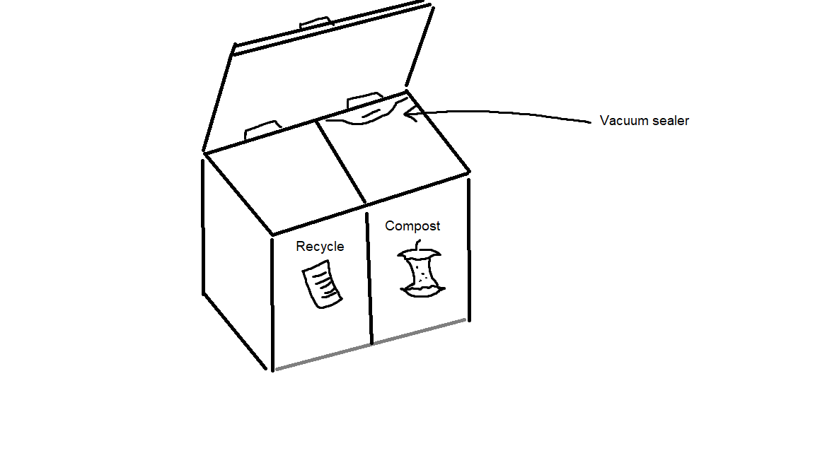
PROTOTYPE 1
Multibin Trashcan
Odorous waste will be placed in the right bin and sealed after each use to prevent odors from escaping. Non-odorous, recyclable waste such as cardboard, and paper will be placed on the left side.

Slide 40
PROTOTYPE 1:
TESTING
We showed a sketch of the multi bin to 15 different participants, highlighting the different compartments and the functions of each space. We gathered information relating to the design and usability and any issues they may experience with using the product. This data allowed us to understand what people wanted in a trash bin, and any additional information regarding the feasibility of the product.
The following questions were asked:
What do you think about the design of the product?
What do you think of the ease of use of the product?
What are you looking for in a trash bin?
What are some of the potential issues you see with the product?
.
Notes:
aa

Slide 41
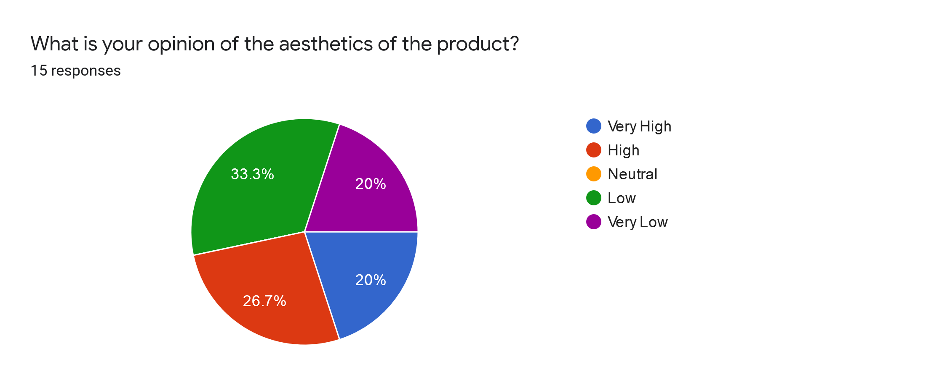
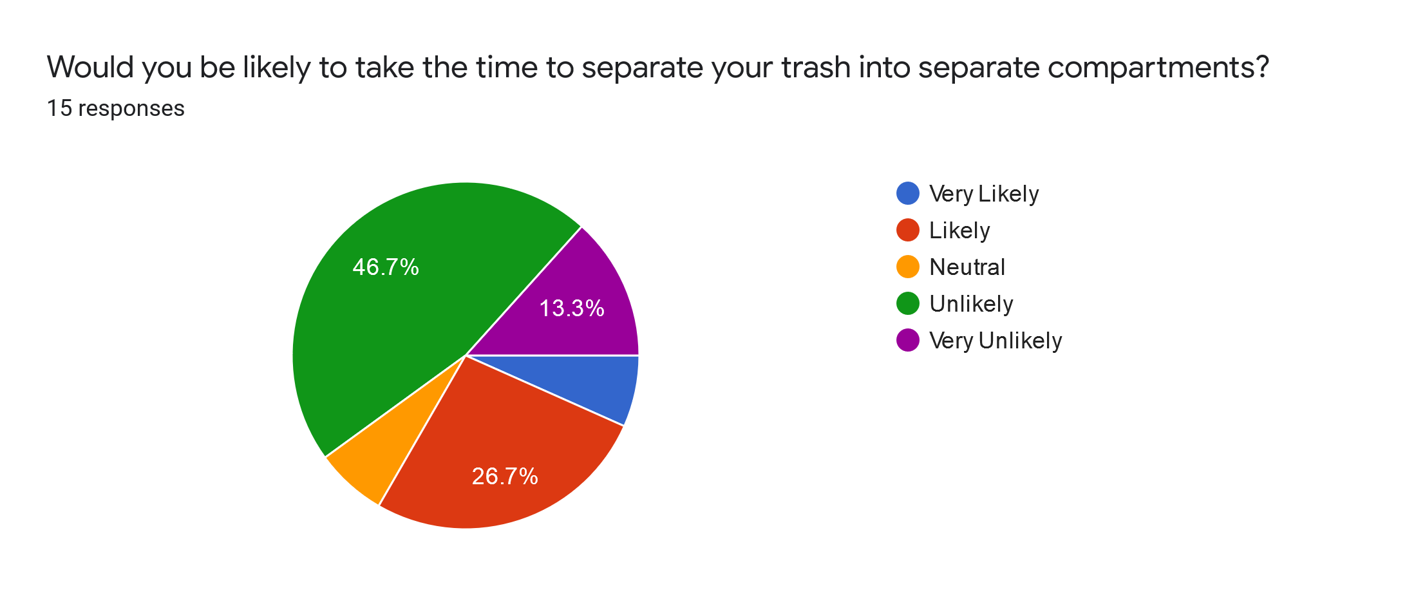
PROTOTYPE 1:
TESTING
7 out of 15 participants (47%) stated that the product’s was aesthetically pleasing.
9 out of 15 participants (60%) seemed uninterested as they didn’t want to take the time to separate their trash.

Slide 42
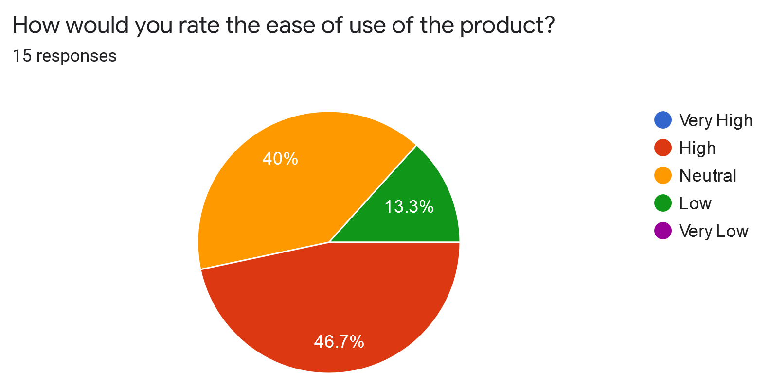
PROTOTYPE 1:
TESTING
7 out of 15 (46.7%) of respondents rated the product’s ease of use as high

Slide 43
PROTOTYPE 1:
TAKEAWAYS
Takeaways:
The product is too bulky and takes up too much space for the typical consumer.
The vacuum sealing process isn’t economically feasible for consumers.
Sealing the bag multiple times after each use would also be an issue with controlling the odorous air.
Consumers’ time is valuable and therefore taking the extra step of separating their trash is not ideal.
For these reasons, our Multibin Trashcan prototype is infeasible and a new solution is necessary.
Going forward:
The design must not impose on the user the need to take additional time to sort their trash.
The design must not consume more space than a typical 30 gallon trash bin.
The design must not include a vacuum sealer.

Slide 44
One-time use odor eliminating canned agent for trash bins. When triggered, by pulling out the tab/seal, the Odor Bomb will react with the air of the trash bin, primary with the common odor causing gases, to create a scented deodorizer that penetrates every part of the trash bin.
Main assumptions being tested:
People are willing to purchase a one time use product to remove unwanted smells in trash bins.
People have a desire to remove unwanted smells from their indoor and outdoor trash cans
All individuals using the same dumpster would use this product for their trash
Answers we are looking for:
Will people like a product that is intended to be one time use? (1 per trash bag)
PROTOTYPE 2

Slide 45
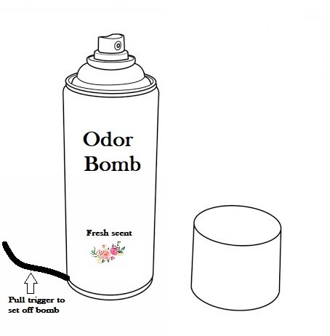
Odor Bomb
PROTOTYPE 2
4’’
Odor bomb is intended to be placed into each trash bag with trigger pulled before tying. Aerosol will spray until can is completely empty, neutralizing the odorous smells within the trash bag. One time use only.

Slide 46
PROTOTYPE 2: TESTING/FEEDBACK
Comments & Concerns:
The majority of the feedback received from the class (58 individuals) expressed concern for the environment since our product contains an aerosol.
People did not like the fact that the odor bomb was intended as a one time use, as this contributes to more waste, harm for the environment, and a higher price for the product.
If this product is used for dumpsters in a back alley setting, how will you force everyone using that dumpster to buy your product? Everyone is affected by smell differently and may not want to use your product, rendering the trash bags that did use the odor bombs as smelly.
Addressing feedback:
In response to the feedback received, our team has made a shift towards a prototype that...
Is environmentally friendly (aerosol contains a natural propellant)
Can be used for up to a month before replacing
Can detect when odor levels surpass a threshold set by the user
Is applied directly to the trash bin, avoiding complications previously faced with prototype 2 with individuals not complying

Slide 47
PROTOTYPE 2:
TAKEAWAYS
Takeaways:
Environmental impact is a large cause for concern for our potential user base (both from the product components themselves and also the single-use method of application).
The single-use application is also an issue for users because of cost concerns.
The effectiveness of the spray bomb was also called into question, as many believed it would not work as anticipated in dumpsters or outdoor trash cans due to the infrequent or inconsistent use of the product.
For these reasons, our Odor Bomb prototype is infeasible and a new solution is necessary.
Going forward:
Our team has decided to focus on a reusable method of application instead of single-use.
To address environmental concerns, any spray or chemical compound we create must not cause any harm to the environment.
The product should also be produced from recycled material to further reduce its environmental impact.

Slide 48
FINAL PROTOTYPE
Sketch a reusable device which senses odor and sprays odor neutralizing aerosol to counteract it. The aerosol will be environmentally friendly and the user will be able to adjust the sensitivity of the sensor to odor. This will also be a low fidelity prototype as we are primarily focused on modeling how our product will look.
Main assumptions being tested:
People have a desire to eliminate foul odor from trash bins in their indoor and outdoor trash cans
Answers we are looking for:
Will people be willing to purchase replacement spray cans for our product?
Is the design of our device compatible with most trash cans ?

Slide 49
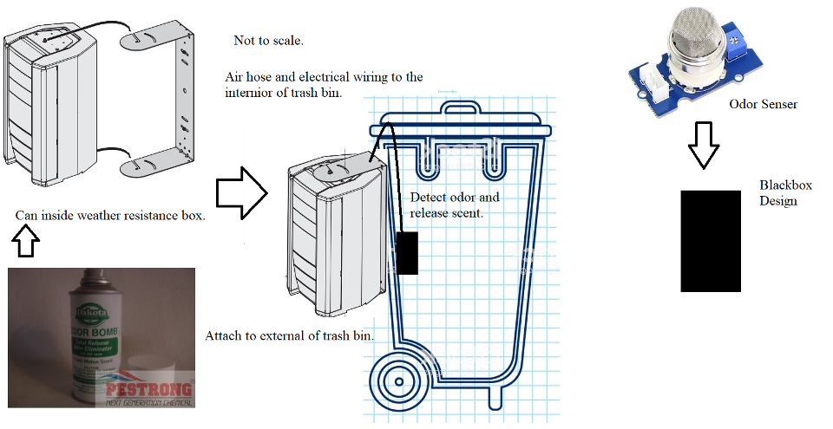
Odor Buster
FINAL PROTOTYPE DESIGN
Blackbox design prevents trash bags from blocking aerosol spray outputs
Notes:
https://www.istockphoto.com/vector/trash-can-line-sketch-icon-isolated-on-white-background-garbage-bin-sign-recycle-gm1158231544-316315890

Slide 50
FINAL PROTOTYPE:
TESTING
We showed 18 different people our sketch prototype and asked for their opinions and feedback on it. The questions our team asked the respondents were aimed to gain insight on:
What they thought of the aesthetics of the product
Their perception of the ease of use of the product
Whether they would be likely to use the product
What potential issues they could identify with the product’s design and application.
The testing we employed gave us the information and insights we needed to finalize the development of our prototype. No additional tests are needed with this prototype.
.

Slide 51
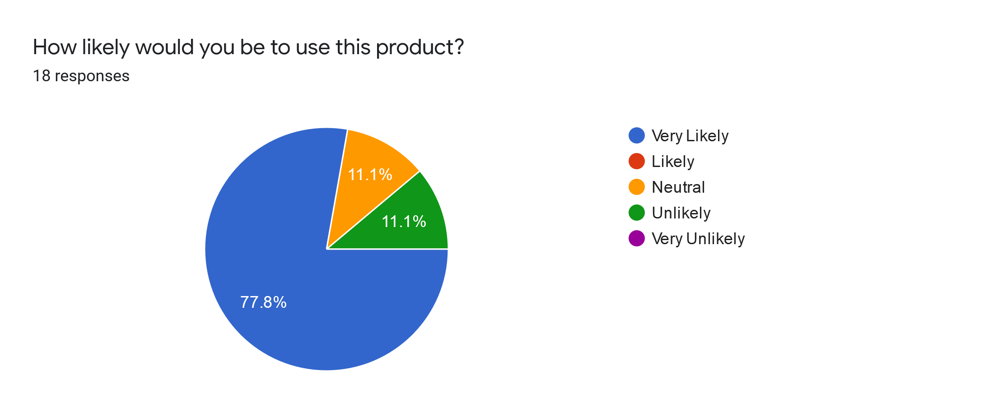
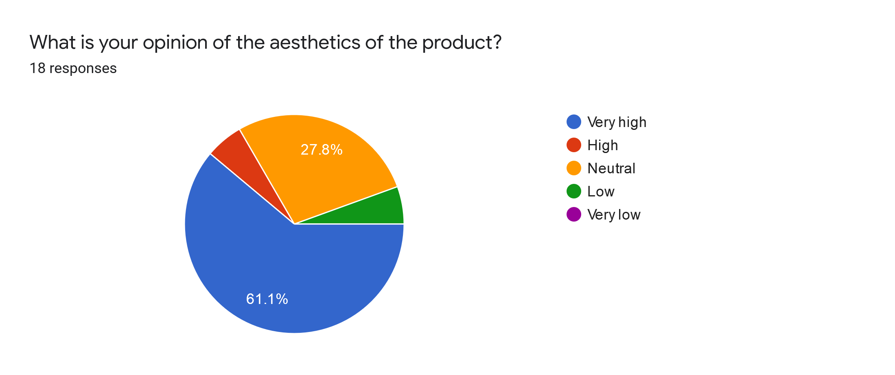
FINAL PROTOTYPE: TESTING
Of the respondents, 14 out of the 18 (77%) expressed a high level of interest in our product and indicated they would be likely to purchase it.
A majority of respondents (67%) also indicated that the design of our product was aesthetically pleasing

Slide 52
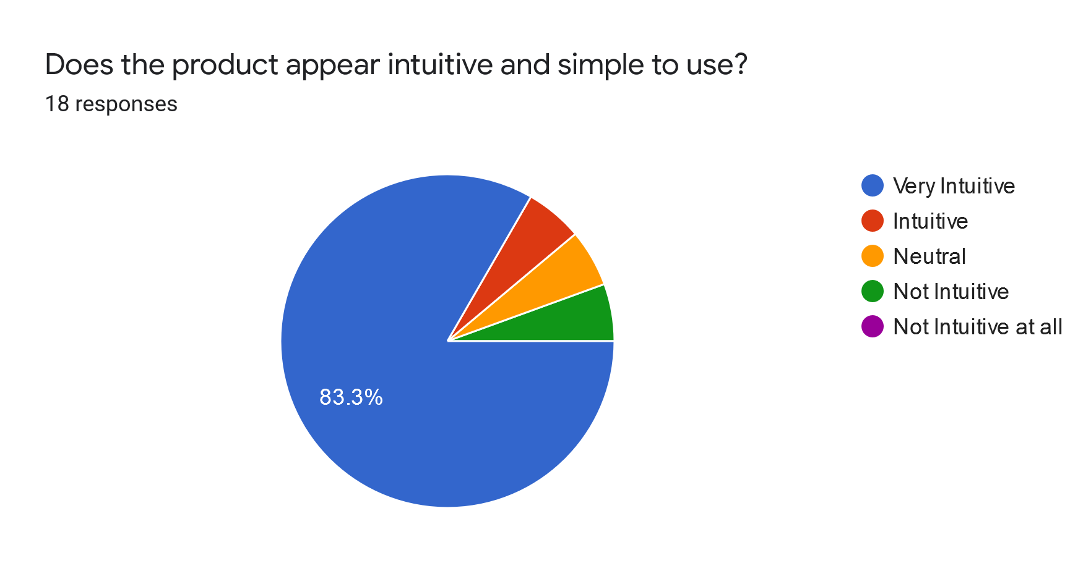
FINAL PROTOTYPE:
TESTING
A few of the respondents expressed concern about the length of the hose - they worried that for some smaller trash bins the hose may be too long.
In the future, we plan to make the hose retractable so that the user pulls out the appropriate length of hose from the box for use and can retract it to fit smaller trash cans or for storage
16 of 18 (88%) respondents stated that the product was intuitive and simple enough for everyday use

Slide 53
FINAL SOLUTION

Slide 54
DECISION MATRIX
Criteria | Rank | Multibin Trashcan | Odor Buster
Feasibility | 6 | 2(12) | 4(24)
Ease of Use | 2 | 4(8) | 5(10)
Reliability | 3 | 3(9) | 4(12)
Cost | 4 | 4(16) | 3(12)
Desirability | 5 | 2(10) | 4(20)
Environmental Impact (Positive) | 1 | 5(5) | 2(2)
Total |  | 60 | 80
*Ranking is from 1-6, 6 being the most important
*Rating is from 1-5, 5 being the highest positive value

Slide 55
EXPLANATION OF CRITERIA
Feasibility: How practical is the solution? Can it be implemented easily? Is it realistic?
Ease of Use: How easily understood is the solution? Does it require many steps to use? Is there are large learning curve in order to properly use the product?
Reliability: How effective is the solution in solving the need/ issue at hand? Does it continue to operate well over time?
Cost: What are the costs associated with the solution?
Desirability: How likely are people to comply in using the product? How much would people actually want to use the product?
Environmental impact: Does the product have a positive effect on the environment? Are any components harmful?

Slide 56
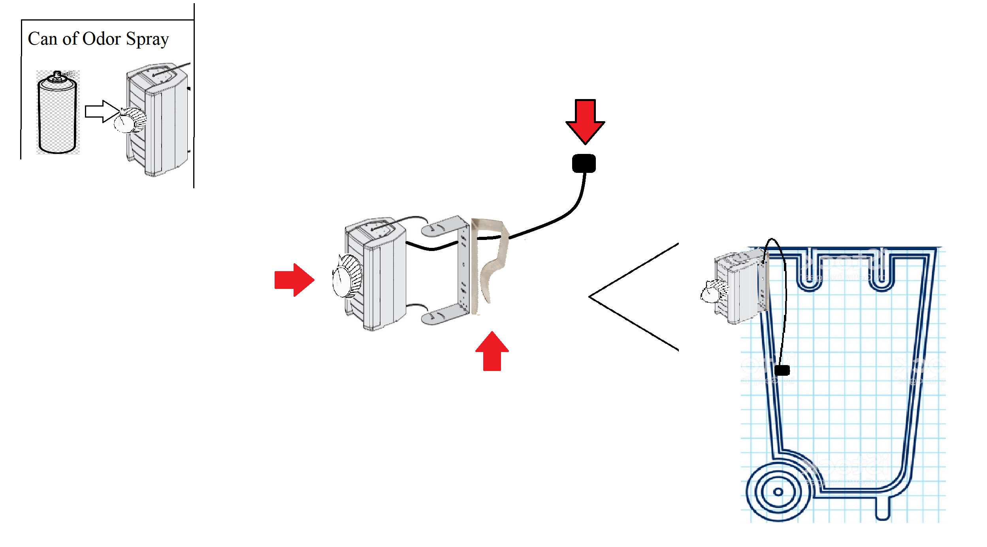
DESIGN
Odor Buster
Odor Sensor and spray output nozzle
Adjustable odor threshold dial
Clip
*Not to scale.

Slide 57
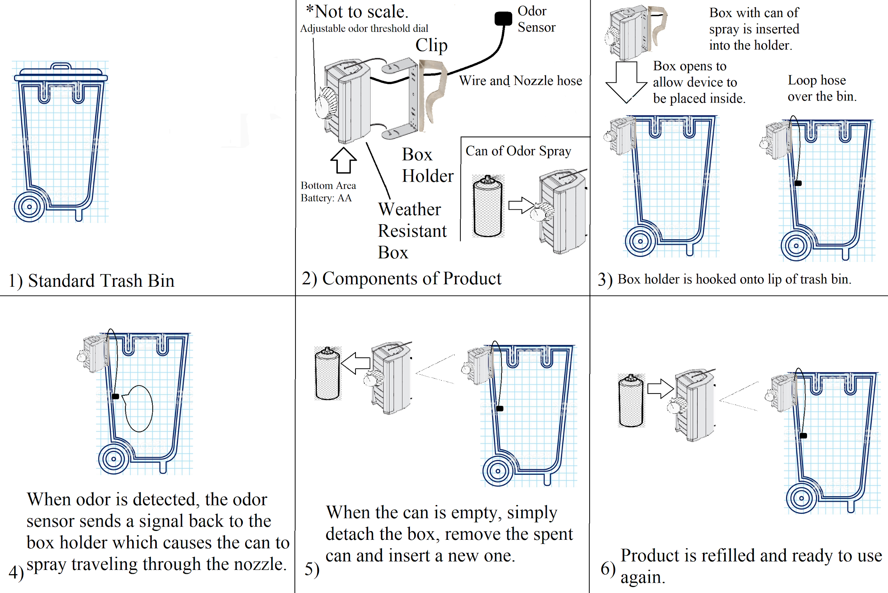
Odor Buster
DESIGN USE
The prototype is a storyboard that outlines the process from setting up the trash bin for use to triggering the product. This will be low fidelity and a work-like prototype as we are primarily focused on modeling the process of using the product.

Slide 58
ODOR BUSTER COMPONENTS
Aerosol Spray/Can Components
The spray includes a hypochlorite disinfectant solution.
Natural propellants , such as compressed gases like carbon dioxide and nitrous oxide, that aren’t harmful to the environment.
Solution: Mixture of distilled water, essential oil, witch hazel, and baking soda [34].
Molecule that seeks out and bonds with odor-producing molecules, turning them into non-odor molecules- neutralizes odor [35].
Spray solution that combats sulfur or nitrogen compounds./ smell inducing agents.
Standard aerosol spray can size (for the A series) is 400~500ml) at 2 11/16 in. x 6 1/16 in. and will be made out of recyclable materials [36].
Upon receiving a trigger signal from the odor detector, an internal mechanism within the box presses the aerosol can to release the spray solution.
The solution is directed through the nozzle hose and released into the trash bin.
Notes:
hypochlorite disinfectant- bleach

Slide 59
ODOR BUSTER COMPONENTS
Detector Components
Utilize a compact smell sensor, like the Aroma Bit SDK-1Q [37], to detect the chemical components in the air to determine odor quality.
The smell sensor would be attached to a simple arduino/microcontroller to control odor threshold and signal transmission.
The detector device would be powered through a battery pack.
The smell sensor would be placed near the end of the nozzle hose close to the centerline of the trash bin.
A wire from the detector device will run attached to the nozzle hose to the weather resistance box.
When the box receives a signal from the odor detector, it triggers the can to release spray for x amount of time once odor suprasses a thershold.
To address the trash blocking say the spray output nozzle is placed inside the black box preventing it from being blocked, the black box can be porous/ grated so the spray can diffuse out.
Threshold is set through a dial on the box which in turn controls the setting on the arduino/microcontroller.
Odor threshold for various chemical in ppm volume is shown in the next slide [38].
Spray 3.5 ml of solution per trigger and will resample the odor in 10 mins to see if another spray is needed.

Slide 60
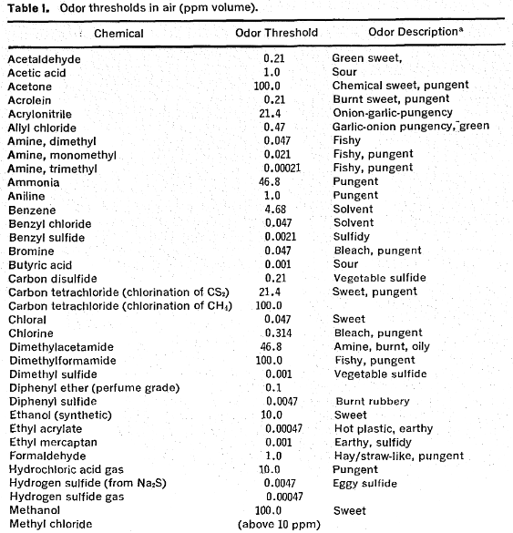
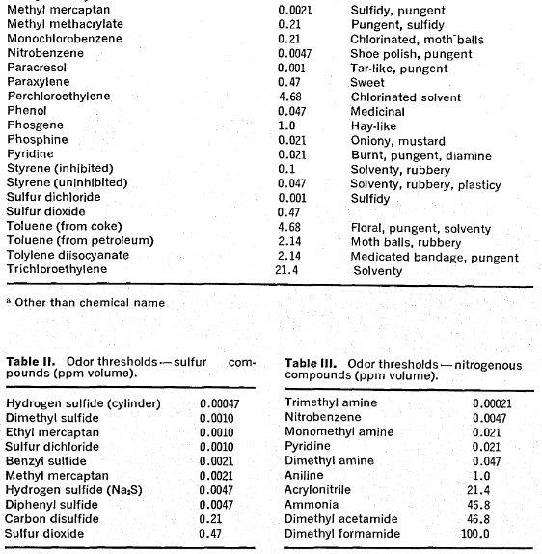
Threshold for odor detection by humans (ppm volume) [38]..

Slide 61
WHY DOES THIS NOT EXIST
At the moment, there are solutions that do not fully resolve the issue, such as scented trash bags, and trash bin deodorizer products. However, these do not fully mask the smell. Furthermore, for the minimal solutions that do exist, none of them are disinfectant, and get rid of any potential harmful bacteria that may be lurking around in the trash can.
Competitors such as Lysol, Glade and Clorox have created many other cleaning products that currently permeate the market. However, they do not directly tackle this need statement of removing the smell of the trash.
Furthermore, most people overlook this issue and either throw their trash out when it starts smelling as they feel they have no other issue. Essentially, the smell is simply being moved from inside their home to in their dumpster. Instead, they can use one of our products, and attach it to their trash bin to reduce the smell so they can take out their trash less frequently.
.

Slide 62
FEASIBILITY
Notes:
Shailia

Slide 63
INNOVATION ASSESSMENT
Our Team
Average Result
Technology or Idea
Market
Customer
Team
Ability to Execute
Notes:
I need the rationale for the innovation assessment rankings.

Slide 64
INNOVATION ASSESSMENT EXPLANATIONS
Technology or Idea
Our Team: Our product is unique and as of now, an exact replica does not exist on the market.
Average Result: Although Lysol disinfectant wipes and Glade plugins are potential solutions, they are not specifically made to get rid of the smell from trash cans, and therefore, it is not as useful of a product for this need statement
Market
Our Team: Our market is not as large as the market of our competitors since they are aimed towards the need for cleanliness as a whole, and we are simply focusing on the need to remove the smell from trash cans.
Average Result: Companies such as Lysol and Clorox have larger markets since they create products to maintain cleanliness on all sorts of surfaces, not just garbage bins.
Customer
Our Team: We do not have a dedicated customer base as of now, however, we would be willing to listen to what the customers need.
Average Result: Lysol and Clorox are names that recognizable in more households in America.
Notes:
The PEST can just list the ideas. Recession should be there etc.

Slide 65
INNOVATION ASSESSMENT EXPLANATIONS
Team
Our Team: We do not have a chemical engineer, and the spray that is contained within the canister will need to be tested by someone who has a background in chemical engineering.
Average Result: Our competitors are larger companies. Therefore, they have more talent and more experience.
Ability to Execute
Our Team: We do not have a chemical engineer, which has been hindering out project ever since we came up with our final solution.
Average Result: Other companies have a much greater ability to execute since they have larger teams and have been established for many years.
Notes:
The PEST can just list the ideas. Recession should be there etc.

Slide 66
SWOT ANALYSIS
 | Helpful | Harmful
 | STRENGTHS Product can detect smell and only dispenses chemical formula when needed Disinfectant- will remove germs and bacteria Environmentally friendly- natural formula, recyclable exterior Smelly trash is an issue almost everywhere Our team is passionate about finding an innovative solution. | WEAKNESSES Most people who do not have such smelly trash would not see this product as useful and worth paying money for Initially, people may not see that it is a long-term use product Our team does not have a chemical engineer on our team.
 | OPPORTUNITIES A product such as this one does not exist on the market as of now, so the competition would be very low. Restaurants could use this product. | THREATS Selling globally means that it would be subject to the status of the economy Not a typical product that homeowners are accustomed to buying
Internal
External
Notes:
I need you to include strengths and weaknesses of your team (SWOT)

Slide 67
PESTLE ANALYSIS
POLITICAL
Getting approval from health officials in government
Making sure there are no health safety regulations that prohibit such a product
ECONOMIC
As this would not be considered a truly “necessary product” for most people, people may not spend money on it if the economy is not doing well.
If there is a recession, the profit from such a product would decrease dramatically.
SOCIAL
People may not believe that they should have to spend money on their trash.
If their friends are not using it, they will also not use it.
TECHNOLOGICAL
In the process of creating this product, we will have to come up with a chemical composition for the spray that suits our needs of eradicating the stench and being a disinfectant.
ENVIRONMENTAL
As our consumers are likely to be environmentally conscious, we hope to have a non-toxic formula for the spray and make the actual canister reusable and recyclable.
LEGAL
Health laws will affect if we are able to put this product into the market.
If the spray causes an allergic reaction in the user, or harms them in any sort of way, they will sue the company.
Notes:
The PEST can just list the ideas. Recession should be there etc.

Slide 68
INITIAL SAFETY ASSESSMENT
No. | System Item | Hazard | Hazard Effects | Comments
1 | Canister | The canister may corrode, leaking out all of the contents. If exposed to high temperatures, pressure can build up inside canister, causing it to explode. | This may burn or cause damage to the hands and face of the user. | Canister should be securely built and pressure resistant.
2 | Solution | The solution may be ingested, or exposed to eyes and face | User may experience vomiting, rash, and eye damage. | Put a label to show the risk of consuming the product, and steps taken if exposed to the solution.
3 | Smell Detector Mechanism | If the user forgets to turn the device off when removing from the trash can, detector may pick up odors causing it to spray near the user | Can cause damage to eyes, vomiting if ingested. | Have an on/off button that can be turned on only after put in trash can.
.
Notes:
Safety should be the PHL table

Slide 69
INITIAL SAFETY ASSESSMENT
No. | System Item | Hazard | Hazard Effects | Comments
4 | Electrical Wiring and Battery | The electrical components may malfunction and cause a fire. | May burn the user and surrounding environment. | Make the device weather resistant, imply safety features.
5 | Battery | The battery may become corrupted and the battery acid may leak. | The user’s hands can experience chemical burns if not rinsed immediately. | Make the device weather resistant and place the battery in a weather tight box.
Notes:
Safety should be the PHL table

Slide 70
VALUE PROPOSITION
Notes:
Shailia

Slide 71
Stakeholder | Value Proposition
Waste Disposal Employees | Our product will help waste disposal employees when they come pick up the waste since it will not have as bad of a smell, and will attract rodents less.
State and Local Governments | As many waste disposal services are funded by the government, this product will help them since it will positively impact town image and perception.
Pedestrians/Commuters | Our product will help those walking along the street since dumpsters they pass by in alleyways will not be as smelly and reduce the amount of unwanted pests.
Environmental Regulators | As this product will be a disinfectant and safe for the environment, it will remove and avoid harmful bacteria from growing that may damage the surrounding ecosystem.
.

Slide 72
Stakeholder | Value Proposition
Residents/Community Members | Residents can buy the product and attach it to their trash cans to remove the smell from dispersing into their living space.
Homeless | This product helps the homeless as they are more likely to pass by large dumpsters placed outside and they will not have to smell the garbage.
Safety Professionals | During safety inspections of cafeterias and restaurants, safety professionals can suggest and encourage the use of this product to establishments that create a lot of waste and need to decrease the smell.
Grocers | Much of the produce sold at grocery stores ends up in the dumpster causing the dumpster to smell. Attaching our product to the dumpster will help decrease this smell.
Restaurants/Food Vendors | Restaurants also product a lot of food waste and would therefore be in our market for this product. They can use these to maintain cleanliness throughout their restaurant.
.

Slide 73
IMPLEMENTATION STRATEGY

Slide 74
BARRIERS
Building a user base will definitely be a difficult process.
We need to build a relationship with the different supermarket companies and online retailers that will be distributing the product.
We will need to consult a team of chemical engineers in order to build the chemical composition of the spray.
We will need to create a high-fidelity prototype to test ourselves and tested with volunteers from the general public.
We may need to get approval from the government and other groups for this product to gain safety credibility.
We need to apply for a patent.
.

Slide 75
MILESTONES
Filing for a patent.
1
Further development of spray or partnering with large brand
2
Launching of the product and gaining user base of 100,000
3
Sell in Big Box retailers
4
Creating dent in the cleaning industry
5

Slide 76
TIMELINE AND ACTION PLAN
Aug 2020
Jan 2021
Feb 2021
Mar 2021
August 2021
Create High- Fidelity Prototype
Test the Prototype
File for a Patent
Talk to potential sponsors
Launch the product
What: Testing the prototype and collecting the data to determine its success. they will be using it over a long period of time.
Who: Volunteers from hoi polloi and the team
Resources: Excel to keep track of the data, copies of the prototype.
Success: Gather enough data to know exactly what needs to be changed before moving on.
What: Testing the prototype and collecting the data to determine its success. they will be using it over a long period of time.
Who: Volunteers from hoi polloi and the team
Resources: Excel to keep track of the data, copies of the prototype.
Success: Gather enough data to know exactly what needs to be changed before moving on.
What: File a patent to establish authority over our design, and the function of our product.
Who: the team
Resources: Contact with the US patent office, necessary paperwork
Success: A patent filed
What: Talk to investors to collect funds to start the project.
Who: The team + investors
Resources: Team, pitch, a network of people
Success: Enough money to manufacture the products, and distribute them to retailers.
What: Manufacture and sell it to distributors.
Who: Team + Retailers such as Amazon and Walmart
Resources: A manufacturing strategy, funds, and connections with different retailers.
Success: Build a user base of 100,000 people

Slide 77


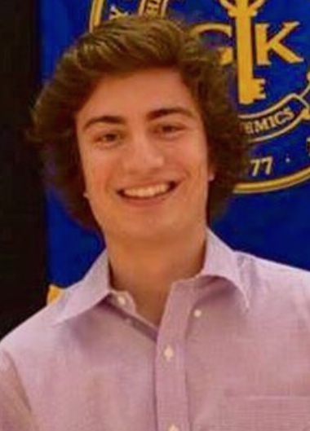
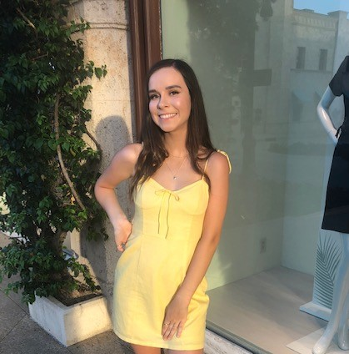


OUR TEAM
Brett Chevalier
Undergraduate
Bachelor’s
Computer Science
Johnny Li
Undergraduate
Bachelor’s
Computer
Engineering
Charles Lazimi
Graduate
Masters
Biomedical Engineering
Annalina Becker
Undergraduate
Bachelor’s
Electrical
Engineering
Jaeyong Sin
Undergraduate
Bachelor’s
Computer Science
Shaila Patel
Undergraduate
Bachelor’s
Computer Science

Slide 78
APPENDIX

Slide 79
REFERENCES
[1] “CDC - Data and Statistics - Sleep and Sleep Disorders.” Centers for Disease Control and Prevention, Centers for Disease Control and Prevention, 2 May 2017, www.cdc.gov/sleep/data_statistics.html.
[2] “Insomnia Market Trends, Size, Share and Analysis By 2023: MRFR.” Insomnia Market Trends, Size, Share and Analysis By 2023 | MRFR, www.marketresearchfuture.com/reports/insomnia-market-545.
[3]“The World's Trash Crisis, and Why Many Americans Are Oblivious.” Los Angeles Times, Los Angeles Times, 22 Apr. 2016, www.latimes.com/world/global-development/la-fg-global-trash-20160422-20160421-snap-htmlstory.html.
[4] “50 Recycling & Trash Statistics That Will Make You Think Twice About Your Trash.” Rubicon Global: Waste, Recycling, and Smart City Technology Company, 12 Dec. 2019, www.rubiconglobal.com/blog/statistics-trash-recycling/.
[5] “National Overview: Facts and Figures on Materials, Wastes and Recycling.” EPA, Environmental Protection Agency, 3 Dec. 2019, www.epa.gov/facts-and-figures-about-materials-waste-and-recycling/national-overview-facts-and-figures-materials.
[6] Rudden, Jennifer. “Numbrt of Houses in U.S.” Statista, Statistica, 17 July 2019, www.statista.com/statistics/240267/number-of-housing-units-in-the-united-states/.
[7]“Dust Mite Allergy.” Asthma and Allergy Foundation of America New England Chapter, 2020, asthmaandallergies.org/asthma-allergies/dust-mite-allergy/.
[8] Andrea d. Steffen. “This Is The First Ever Microplastics Filter For Washing Machines!” Intelligent Living, NPR, 12 Sept. 2019, www.intelligentliving.co/microplastics-filter-washing-machines/.
[9] “Municipal Solid Waste Factsheet.” Municipal Solid Waste Factsheet | Center for Sustainable Systems, css.umich.edu/factsheets/municipal-solid-waste-factsheet.
[10] Gridwaste.com, www.gridwaste.com/news/2014/8/20/10l92d52vzaw1zdsf0znubdqpttq7k.

Slide 80
REFERENCES
[11] “Waste Management Services Industry Profile.” First Research, www.firstresearch.com/Industry-Research/Waste-Management-Services.html.
[12] Amadeo, Kimberly. “The Rising Costs of Pollution and What Can Be Done About It.” The Balance, www.thebalance.com/pollution-facts-economic-effect-4161042.
[13] Curtin, Melanie. “73 Percent of Millennials Are Willing to Spend More Money on This 1 Type of Product.” Inc.com, Inc., 30 Mar. 2018, www.inc.com/melanie-curtin/73-percent-of-millennials-are-willing-to-spend-more-money-on-this-1-type-of-product.html.
[14]C. Interest, "Talking Trash – The Chemistry Behind the Smell of Garbage | SciTech Connect", Scitechconnect.elsevier.com, 2017. [Online]. Available: http://scitechconnect.elsevier.com/talking-trash-chemistry-behind-garbage-smell/. [Accessed: 06- Apr- 2020].
[15]"Residential Building Context - Zero Waste", Zerowastedesign.org, 2020. [Online]. Available: https://www.zerowastedesign.org/02-building-design/a-residential-building-context/. [Accessed: 06- Apr- 2020]
[16]"Cookie cutter homes Northwood.", Flickr, 2020. [Online]. Available: https://www.flickr.com/photos/volvob12b/9735246361. [Accessed: 08- Apr- 2020].
[17]"Trash Pickup Day", Flickr, 2020. [Online]. Available: https://www.flickr.com/photos/paul_garland/3445357168/. [Accessed: 08- Apr- 2020].
[18]Pixabay, 2018. [Online]. Available: https://pixabay.com/photos/city-building-city-view-hong-kong-3479701/. [Accessed: 08- Apr- 2020]..
[19] “KR20180053579A - Scented trash cans,” Google Patents. [Online]. Available: https://patents.google.com/patent/KR20180053579A/en?q=odor+elimanting+trash&language=ENGLISH&oq=odor+elimanting+trash+can+language:ENGLISH. [Accessed: 08-Apr-2020].

Slide 81
REFERENCES
[20] “KR20050014327A - A Food Trash Ordor Removal Unit and Method thereof,” Google Patents. [Online]. Available: https://patents.google.com/patent/KR20050014327A/en?q=odor+detection+trash+cans&oq=odor+detection+in+trash+cans. [Accessed: 08-Apr-2020].
[21]E. Duffin, "U.S.: Number of households 1960-2019 | Statista", Statista, 2019. [Online]. Available: https://www.statista.com/statistics/183635/number-of-households-in-the-us/. [Accessed: 09- Apr- 2020].
[22]“Number of Municipal Governments & Population Distribution,” NLC National League of cities. [Online]. Available: https://www.nlc.org/number-of-municipal-governments-population-distribution. [Accessed: 15-Apr-2020].
[23] TY - JOURAU - Quercia, DanieleAU - Schifanella, RossanoAU - Aiello, LucaAU - McLean, KatePY - 2015/05/26SP -T1 - Smelly Maps: The Digital Life of Urban SmellscapesER -
[24]"Top Sulfur-Rich Foods And Why You Need Them", Change-Links, 2020. [Online]. Available: http://change-links.org/top-sulfur-rich-foods-and-why-you-need-them/. [Accessed: 11- Apr- 2020].
[25]"Ammonia used in many foods, not just "pink slime"", U.S., 2020. [Online]. Available: https://www.reuters.com/article/us-food-ammonia/ammonia-used-in-many-foods-not-just-pink-slime-idUSBRE8331B420120404. [Accessed: 11- Apr- 2020].
[26]"Natural Compound Protects Hypertensive Rats against Heart Disease", Sci News, 2018. [Online]. Available: http://www.sci-news.com/medicine/trimethylamine-n-oxide-hypertensive-rats-heart-disease-06599.html. [Accessed: 11- Apr- 2020].
[27]2020. [Online]. Available: https://www.meijer.com/shop/en/pantry/oil-vinegar-dressing/salad-dressing/wish-bone-house-italian-salad-dressing-15-oz/p/4132100648. [Accessed: 11- Apr- 2020].

Slide 82
REFERENCES
[28]K. Guiden, "Chemicals in Food: Two That Aren't As Scary As They Sound — IFIC Foundation", IFIC Foundation, 2020. [Online]. Available: https://foodinsight.org/chemicals-in-food-two-that-arent-as-scary-as-they-sound/. [Accessed: 11- Apr- 2020].
[29]I. Muralikrishna and V. Manickam, "Organic Waste - an overview | ScienceDirect Topics", Sciencedirect.com, 2017. [Online]. Available: https://www.sciencedirect.com/topics/earth-and-planetary-sciences/organic-waste. [Accessed: 11- Apr- 2020].
[30]B. Gringer, "The Trash One Person Produces in One Year", TitleMax, 2020. [Online]. Available: https://www.titlemax.com/discovery-center/lifestyle/trash-one-person-produces-year/. [Accessed: 11- Apr- 2020].
[31]R. Fry, "The number of people in the average U.S. household is going up for the first time in over 160 years", Pew Research Center, 2019. [Online]. Available: https://www.pewresearch.org/fact-tank/2019/10/01/the-number-of-people-in-the-average-u-s-household-is-going-up-for-the-first-time-in-over-160-years/. [Accessed: 11- Apr- 2020].
[32]"Converting Your Food Waste Into Energy | SaveOnEnergy.com", Saveonenergy.com. [Online]. Available: https://www.saveonenergy.com/food-power-per-hour/. [Accessed: 11- Apr- 2020].
[33]"10 Shocking USA Food Waste Stats – The Swag USA", The Swag USA. [Online]. Available: https://swagoz.com/10-shocking-usa-food-waste-stats/. [Accessed: 11- Apr- 2020].
[34] “DIY Stinky Shoe Spray,” One Essential Community, 10-Dec-2019. [Online]. Available: https://oneessentialcommunity.com/diy-stinky-shoe-spray-essential-oils/. [Accessed: 12-Apr-2020].
[35] USN Products, LLC, “Multipurpose Odor Eliminator Spray,” USN Products, LLC. [Online]. Available: https://www.u-savenow.com/products/rmr-odor-x-multipurpose-extreme-odor-eliminator. [Accessed: 12-Apr-2020].
[36] Aerosol Can Manufacturer Producing Different Sizes of Aerosol Cans. [Online]. Available: https://www.kianjoocan.com.my/index.php?id=47. [Accessed: 12-Apr-2020].

Slide 83
REFERENCES
[37]“aroma bit: 株式会社アロマビット,” aroma bit. [Online]. Available: http://aromabit.com/newproduct_sdk_20181201_en/. [Accessed: 12-Apr-2020].
[38] G. Leonardos, D. Kendall, and N. Barnard, “Odor Threshold Determinations of 53 Odorant Chemicals,” Journal of the Air Pollution Control Association, vol. 19, no. 2, pp. 91–95, 1969.

Slide 84
INTERVIEW TRANSCRIPTS
Interview 1 – Stakeholder Group: Resident
How do you currently deal with the issue of smell from trash when you encounter it?
“Take out the trash whenever I notice the odor (in my own home) or just avoid it when I’m outside.”
What would you be willing to pay for a product that solves this issue?
“Maybe around $20-30 if it actually worked and I never smelled odor from my trash can again”
How does this problem impact your life?
“It doesn’t have a very large impact on my life, I find it a nuisance but since I’ve dealt with it for so long I’m not extremely bothered by it anymore.”
Why do you think this remains an issue today?
“How would you alleviate the smell for every trash bin on the street in an affordable way? That would be very difficult, and I believe that’s the main reason why this hasn’t changed.”
What would be the benefit(s) of solving this problem to you personally and to society at large?
“I think it would be awesome to see the smell issue completely solved. The ‘clutter’ issue isn’t something I really care about.”

Slide 85
INTERVIEW TRANSCRIPTS
Interview 2 – Stakeholder Group: Resident
How do you currently deal with the issue of smell from trash when you encounter it?
“I take the bag to the trash chute or spray air freshener on it if it’s not horrible. I we’re talking about outside, then I drive most places so I won’t really have to deal with that”
What would you be willing to pay for a product that solves this issue?
$10-15
How does this problem impact your life?
“I don’t want to go in the room when the trash is really smelly, and I would avoid areas outside on the sidewalk or wherever if there is trash there.”
Why do you think this remains an issue today?
“Because people are lazy and the current system of putting trash on the curb is the easiest thing to do.”
What would be the benefit(s) of solving this problem to you personally and to society at large?
“A solution to the smell would be nice, but the only solution I can think of is some kind of new trash can, so I don’t know how you can get very creative with that. I’d be less likely to use it if there was less space than a normal trash can.”

Slide 86
INTERVIEW TRANSCRIPTS
Interview 3 – Stakeholder Group: Commuter
How do you currently deal with the issue of smell from trash when you encounter it?
“I usually just ignore it if it’s not in my house to be honest. It bothers me but what can I do if it’s not my trash.”
What would you be willing to pay for a product that solves this issue?
$10-15
How does this problem impact your life?
“The smell annoys me a lot but I don’t think the bins on the street are a real problem”
Why do you think this remains an issue today?
“There probably aren’t any good solutions to alleviate the smell issue in public areas”
What would be the benefit(s) of solving this problem to you personally and to society at large?
“Solving the smell would be great, but I don’t think it’s something I’d spend a good amount of money on.”

Slide 87
INTERVIEW TRANSCRIPTS
Interview 4 – Stakeholder Group: Resident
How do you currently deal with the issue of smell from trash when you encounter it?
“Febreze or something like that, or take out the garbage if that doesn’t work”
What would you be willing to pay for a product that solves this issue?
$15-20
How does this problem impact your life?
“Usually I’m not personally affected by the garbage bins on the street problem, but I’m sure that it does contribute to pests and germs and such.”
Why do you think this remains an issue today?
“Not an easy issue to solve, there wouldn’t be many local governments willing to make a substantial change to their waste management systems to solve this.”
What would be the benefit(s) of solving this problem to you personally and to society at large?
“Personally I would benefit from not having the smell in my apartment, but when it comes to garbage on the street – what is the point of just me buying a new kind of garbage bin or something? One person buying the product wouldn’t change much”

Slide 88
INTERVIEW TRANSCRIPTS
Interview 5 – Stakeholder Group: Resident
How do you currently deal with the issue of smell from trash when you encounter it?
“My way of mitigating the smell is putting certain foods down the garbage disposal, and being aware of when I put stinky things in the trash bin. I know that I’ll have to change the bag soon after that. Sprinkling baking soda over stinky food in the bin helps as well.”
What would you be willing to pay for a product that solves this issue?
$20-25
How does this problem impact your life?
“It is a pretty big deal for me because I have a sensitive nose. I’m particularly bothered by the sulfur smell that a lot of food waste tends to give off. The ‘clutter’ issue doesn’t seem very important to me, at least in my area.”
Why do you think this remains an issue today?
“It’s certainly not a simple problem to address, particularly the clutter issue. There doesn’t seem to be a direct and quick way to solve it.”
What would be the benefit(s) of solving this problem to you personally and to society at large?
“Mitigating the smell of trash on the street (and also in the home) would be a huge benefit to me, and I can imagine that fixing the clutter issue would be useful in many places. I think you would essentially have to create some kind of new trash bin for that purpose, and if that’s the route you go it would be important to ensure its ergonomic and light enough to carry to the street”

Slide 89
INTERVIEW TRANSCRIPTS
Interview 6 – Stakeholder Group: Commuter
How do you currently deal with the issue of smell from trash when you encounter it?
“For garbage on the street, I try to ignore it and move away. In my apartment, I would take the garbage out or ignore it depending on the severity.”
What would you be willing to pay for a product that solves this issue?
$15-20
How does this problem impact your life?
“The problem affects me much more when I am back home and there are a lot of trash cans lining the street near my parents house. A lot of times the trash bags rip open on the street too, making the smell even worse.”
Why do you think this remains an issue today?
“I don’t know how you would solve the trash cans on the street issue without community-wide agreement to implement the solution, and that could cost them a lot of money. There’s not a lot of incentive for them to spend taxpayer money on this issue.”
What would be the benefit(s) of solving this problem to you personally and to society at large?
“Well, obviously getting rid of the odor everywhere by the bins would be great, when there’s lots of them close together the smell is amplified a lot. It might make parking better too if the bins are removed entirely from the curb.”

Slide 90
INTERVIEW TRANSCRIPTS
Interview 7 – Stakeholder Group: Commuter
How do you currently deal with the issue of smell from trash when you encounter it?
“I’ll leave or walk across the street. In my home I would just take out the trash and put a new bag in. I use those scented trash bags to get rid of some of the odor.”
What would you be willing to pay for a product that solves this issue?
$20-25
How does this problem impact your life?
“It’s a problem for sure, I usually go running at night and I’ll go a different route on nights when everyone has their trash cans out”
Why do you think this remains an issue today?
“It’s probably not high on the priority list for most people. I think any product you come up with needs to be simple, and that can be difficult to accomplish. I wouldn’t buy it if it’s too complex.”
What would be the benefit(s) of solving this problem to you personally and to society at large?
“The odor is a big problem that would be great to see solved. I think a lot of businesses, particularly restaurants, can benefit from this as well if you could create something that helps the smell in their kitchens or dumpsters. I know I would buy a product like that.”

Slide 91
INTERVIEW TRANSCRIPTS
Interview 8 – Stakeholder Group: Resident
How do you currently deal with the issue of smell from trash when you encounter it?
“I change the trash bag, clean the bin, and maybe spray some air freshener as well if I could still smell something. (For outside) I’ll just avoid walking past the bins or bags on the curb if possible”
What would you be willing to pay for a product that solves this issue?
Around $15-20
How does this problem impact your life?
“It bothers me a fair bit when I’m out walking my dog, I definitely change up the route I walk on trash collection days so I’m not walking right by a ton of trash.”
Why do you think this remains an issue today?
“Mostly likely it is because not a lot of attention is paid to it, people just typically avoid it and then forget about it.”
What would be the benefit(s) of solving this problem to you personally and to society at large?
“It would be nice to be rid of the trash bins lining the streets if there was a way to do that, but the odor is the worst thing for me. Getting rid of the odor would be a much greater benefit to me personally and society.”

Slide 92
INTERVIEW TRANSCRIPTS
Interview 9 – Stakeholder Group: Resident
How do you currently deal with the issue of smell from trash when you encounter it?
“Promptly take out the garbage when it gets smelly at all. (Outside) I would avoid walking or biking through my neighborhood on trash night when possible.”
What would you be willing to pay for a product that solves this issue?
$20-25
How does this problem impact your life?
“I’m sure I use many more trash bags than the average person because I can’t stand to let the trash sit there when it starts to stink. I find it bothersome to have to do it relatively often.”
Why do you think this remains an issue today?
“This remains an issue today because all the current solutions I can think of are either too expensive or ineffective. For trash bins (on the curb) I really don’t see how you’d change that without overhauling the whole trash system.”
What would be the benefit(s) of solving this problem to you personally and to society at large?
“If there was a way to eliminate the trash bins from the curb entirely that would likely increase property values, improve cleanliness in the area, and solve the odor issue as well. For myself, the biggest improvement would be stopping the smell.”

Slide 93
INTERVIEW TRANSCRIPTS
Interview 10 – Stakeholder Group: Commuter
How do you currently deal with the issue of smell from trash when you encounter it?
“I tie off any meat or smelly food waste in a separate bag before putting it in the trash bin. It’s not perfect at all but helps a fair amount.” “For outside, I can’t do much more than holding my nose and keep moving”
What would you be willing to pay for a product that solves this issue?
“I think I’d pay around $10-25”
How does this problem impact your life?
“I’d say it is a nuisance in the home, and something I would like fixed. When I’m outside it’s not the biggest deal because I can just walk by wherever is smelly. The outside smell is not something that I think about a lot.”
Why do you think this remains an issue today?
“It’s easy to forget that this is a problem because in most areas the trash isn’t on the curb constantly, it may only be out there one or two days a week.”
What would be the benefit(s) of solving this problem to you personally and to society at large?
“Getting rid of the clutter would maybe make driving easier in crowded streets, I think it’s more important to focus on the smell though because that is something that affects everyone all the time, in home and on the streets.”

Slide 94
CREDITS
Presentation template by Slidesgo
Icons by Flaticon

